Slide 1
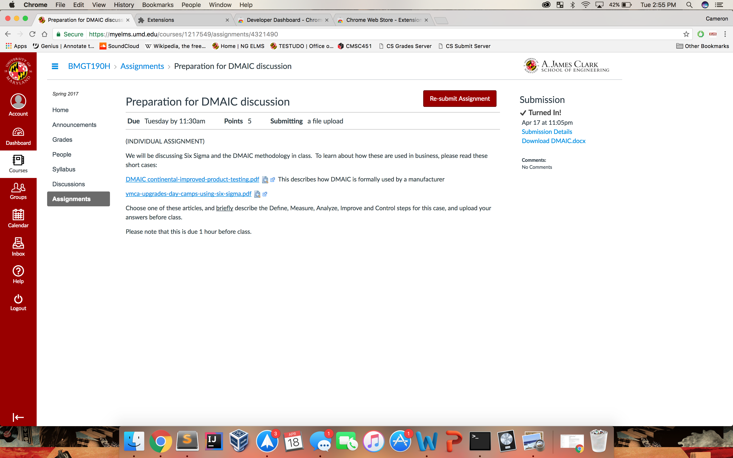
If you still want to download files,
you can click the icon to toggle between on and off.
Will open in tab instead of downloading.

